Slide 1
The Nutcracker
By Adam Smith and Sergio Matlalcuatzi

Slide 2
How it Began
Ivan Vsevolozhsky made and designed the original Nutcracker but it was not a success. The 20 min suite that Tchaikovsky extracted from the ballet was. However, the complete Nutcracker has enjoyed mass amounts of popularity since the late 1960s and is now performed by countless ballet companies, mainly during the Christmas season.

Slide 3
Ivan Vsevolozhsky
Ivan Vsevolozhsky was the music writer, producer, and the creator of the Nutcracker and to help him was Marius Petipa, who had helped in the creation of The Sleeping Beauty. Vsevolozhsky made the Nutcracker as a two part ballet. Petipa gave Vsevolozhsky specific detailed instructions for the composition of each number , down to the tempo and the bars.

Slide 4
Then…
The first performance of the Nutcracker did not end well. The reaction to the dancers was ambivalent. While most critics praised Dell 'Era on her point work as the Sugar Plum Fairy , one critic called her “pudgy” and “corpulent”. The libretto was criticized for being “lopsided” (the end is near).

Slide 5
Acts
Act I . Angels Act II
. President . Angels
. His wife . Sugar Plum Fairy
. Guests . Clara
. Children(Clara, Fritz) . Nutcracker Prince
. Parents . 12 pages
. Councilor Drosselmeyer . Eminent members of the court
. Dolls . Spanish Hot Chocolate Performers
. Nutcracker . Arabian coffee performers
. Owl . Chinese tea performers
. Mice . Russian candy cane performers
. Sentinel . Danish Marzipan Shepherdesses Performers
. Hare-Drummers . Mother Gigogne
. Mouse King . Dewdrop
. Soldiers . Flowers
. Snowflakes . Sugar Plum Fairy Cavalier

Slide 6
The Music: part I
Act I
№01 Petite ouverture
№02 Scène: Une fête de Noël
№03 Marche et petit galop des enfants
№04 Danse des incroyables et merveilleuses
№05 Entrée de Drosselmeyer
№06 Danses des poupées mécaniques—
a. Arlequin et Columbine; Pas de deuxb. La Recruit et la vivandière№07 Le Casse-Noisette (Polka et la berceuse)
№08 Danse "Grossvater"
№09 Grand scène fantastique
№10 La bataille de Casse-Noisette et du Roi des souris
№11 Le voyage
№12 Valse des flocons de neige

Slide 7
The Music: part II
Act II
№13 Introduction; Scène de Confiturembürg
Grand divertissement—
№14 "Chocolat" (Danse espagnole)№15 "Café" (Danse arabe)№16 "Thé" (Danse chinoise)№17 Danse des Bouffons№18 Danse des mirlitons№19 La mère Gigogne et les polichinelles№20 Grand ballabile№21 Pas de deux—
a. Grand adageb. Variation de Prince Coqueluche (M. Pavel Gerdt)c. Variation de la Fée-Dragée (Mlle. Antoinetta Dell-Era)d. Grand coda№22 Coda générale
№23 Apothéose: Une ruche

Slide 8
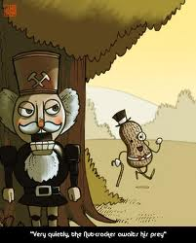
Sneaky

Slide 9
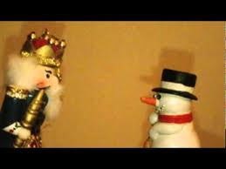
Staring contest

Slide 10
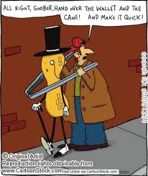
And then….

Slide 11
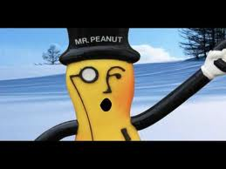
Don’t worry, be happy.

