Slide 1
the nutcracker
By; Keely Catrett & Trinitee Nez

Slide 2
Who helped make the nutcracker
Ivan Vsevolozhsky was the director.
Tchaikovsky wrote the music.
Marius Pelpa wrote the ballet.

Slide 3
What influenced the nut cracker?
What influenced the Nutcracker was E.T.A Hoffmann’s story “The Nutcracker and the King of Mice” by Alexander Dumas P`ere.

Slide 4
why did tchaikovsky write the music for the nutcracker?
At Frolovskoe, Rouen and Maidanovo between mid/late February and late June/early July 1891 at Maidanovo, January–March 1892. Written at the request of the Director of the Imperial Theatres, Ivan Vsevolozhsky asked Tchaikovsky to write the music for the Nutcracker.

Slide 5
What is in the music of the nutcracker?
2 Piccolos, 3 Flutes, 2 Oboes, English Horn, 2 Clarinets Bass Clarinets, 2 Bassoons + 4 Horns ,2 Trumpets, 3 Trombones, Tuba + Timpani, Triangle, Castanets, Tambourine, Children's Instruments Trumpet , Drums, Cuckoo , Quail , Cymbals, Bass Drum, Tam-Tam, Glockenspiel + Celesta (or Piano), 2 Harps, Violins I, Violins II, Violas, Cellos, Double Basses + Chorus.

Slide 6
A summary of the nutcracker
In the nutcracker ,Clara gets a nutcracker for Christmas at the Christmas party at her house by her godfather Drosselmeyer. Clara falls asleep under the tree with her nutcracker in her hand . Clara shrinks and on her adventure The Mouse King appears. It fights the nutcracker with both their armies. The Mouse King wins and takes the nutcracker.

Slide 7
Clara throws her slipper at the Mouse King and it hits him in the forehead and he dies. Then the nutcracker turns into a prince and they go to the Land of Snow. Then they go to the Land of Sweets there they meet the Sugar Plum Fairy and they tell her about their fight with the mouse king and she rewards them with many different dances. Then Clara wakes up under the Christmas tree with the nutcracker in her hand.

Slide 8
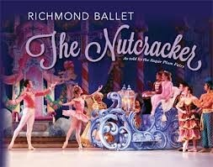
Merry Christmas!!

Slide 9
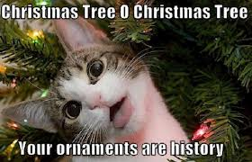
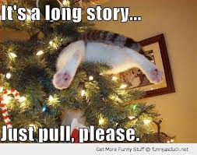
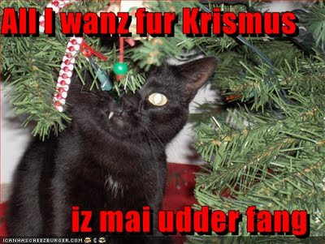

Slide 10
